Slide 1
可靠数据传输

Slide 2
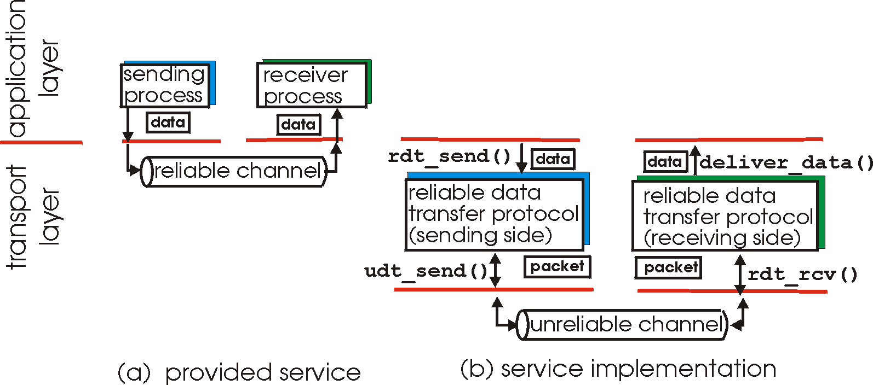
Principles of Reliable data transfer
important in app., transport, link layers
top-10 list of important networking topics!
characteristics of unreliable channel will determine complexity of reliable data transfer protocol (rdt)

Slide 3
Principles of Reliable data transfer
important in app., transport, link layers
top-10 list of important networking topics!
characteristics of unreliable channel will determine complexity of reliable data transfer protocol (rdt)

Slide 4
Principles of Reliable data transfer
important in app., transport, link layers
top-10 list of important networking topics!
characteristics of unreliable channel will determine complexity of reliable data transfer protocol (rdt)

Slide 5
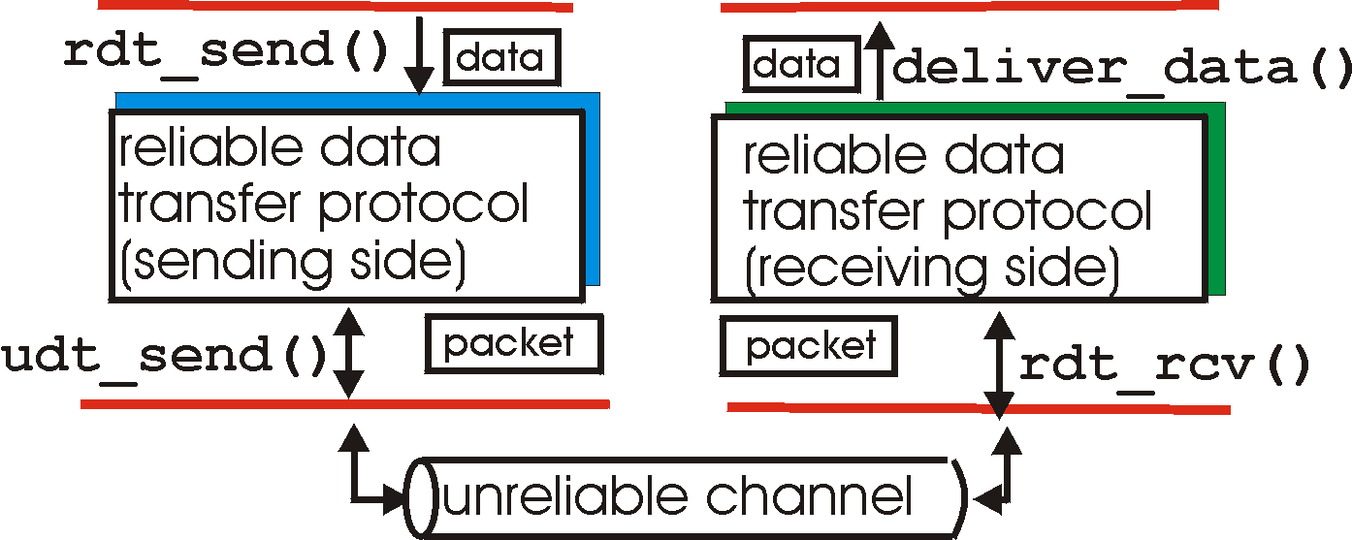
Reliable data transfer: getting started
rdt_send(): called from above, (e.g., by app.). Passed data to
deliver to receiver upper layer
deliver_data(): called by rdt to deliver data to upper
send
side
receive
side
udt_send(): called by rdt,
to transfer packet over
unreliable channel to receiver
rdt_rcv(): called when packet arrives on rcv-side of channel

Slide 6
Reliable data transfer: getting started
We’ll:
incrementally develop sender, receiver sides of reliable data transfer protocol (rdt)
consider only unidirectional data transfer
but control info will flow on both directions!
use finite state machines (FSM) to specify sender, receiver
event causing state transition
actions taken on state transition
state: when in this “state” next state uniquely determined by next event
state
1
state
2
event
actions

Slide 7
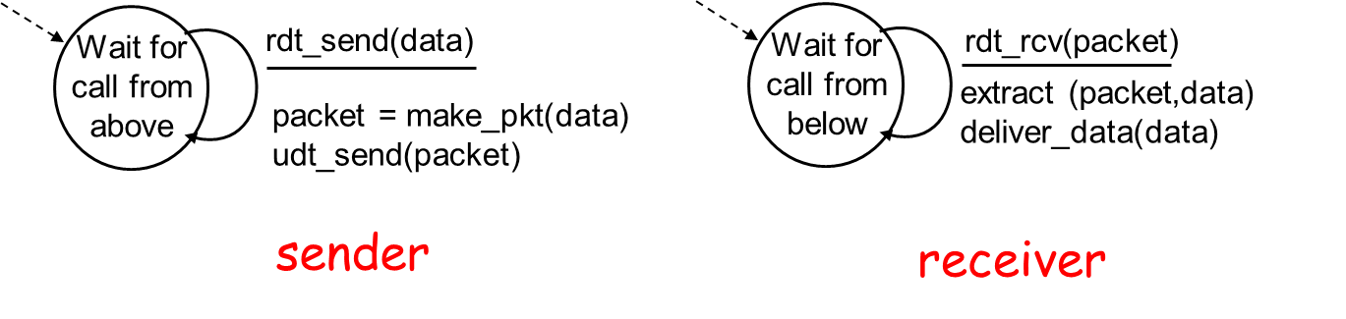
Rdt1.0: reliable transfer over a reliable channel
underlying channel perfectly reliable
no bit errors
no loss of packets
separate FSMs for sender, receiver:
sender sends data into underlying channel
receiver read data from underlying channel

Slide 8
Rdt2.0: channel with bit errors
underlying channel may flip bits in packet
checksum to detect bit errors
the question: how to recover from errors:
acknowledgements (ACKs): receiver explicitly tells sender that pkt received OK
negative acknowledgements (NAKs): receiver explicitly tells sender that pkt had errors
sender retransmits pkt on receipt of NAK
new mechanisms in rdt2.0 (beyond rdt1.0):
error detection
receiver feedback: control msgs (ACK,NAK) rcvr->sender

Slide 9
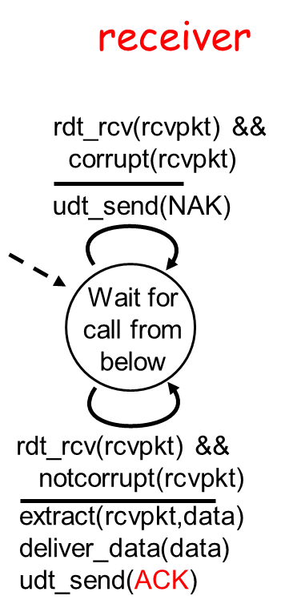
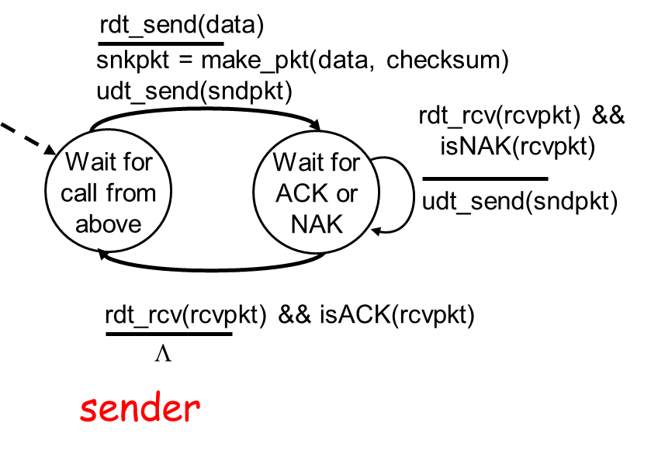
rdt2.0: FSM specification

Slide 10
rdt2.0: operation with no errors
rdt_send(data)
snkpkt = make_pkt(data, checksum)
udt_send(sndpkt)
rdt_rcv(rcvpkt) &&
isNAK(rcvpkt)
Wait for ACK or NAK
rdt_rcv(rcvpkt) &&
corrupt(rcvpkt)
Wait for call from above
udt_send(sndpkt)
udt_send(NAK)
rdt_rcv(rcvpkt) && isACK(rcvpkt)
Λ
Wait for call from below
rdt_rcv(rcvpkt) &&
notcorrupt(rcvpkt)
extract(rcvpkt,data)
deliver_data(data)
udt_send(ACK)

Slide 11
rdt2.0: error scenario
rdt_send(data)
snkpkt = make_pkt(data, checksum)
udt_send(sndpkt)
rdt_rcv(rcvpkt) &&
isNAK(rcvpkt)
Wait for ACK or NAK
Wait for call from above
rdt_rcv(rcvpkt) &&
corrupt(rcvpkt)
udt_send(sndpkt)
udt_send(NAK)
rdt_rcv(rcvpkt) && isACK(rcvpkt)
Λ
Wait for call from below
rdt_rcv(rcvpkt) &&
notcorrupt(rcvpkt)
extract(rcvpkt,data)
deliver_data(data)
udt_send(ACK)

Slide 12
rdt2.0 has a fatal flaw!
What happens if ACK/NAK corrupted?
sender doesn’t know what happened at receiver!
can’t just retransmit: possible duplicate
Handling duplicates:
sender retransmits current pkt if ACK/NAK garbled
sender adds sequence number to each pkt
receiver discards (doesn’t deliver up) duplicate pkt
stop and wait
Sender sends one packet,
then waits for receiver
response

Slide 13
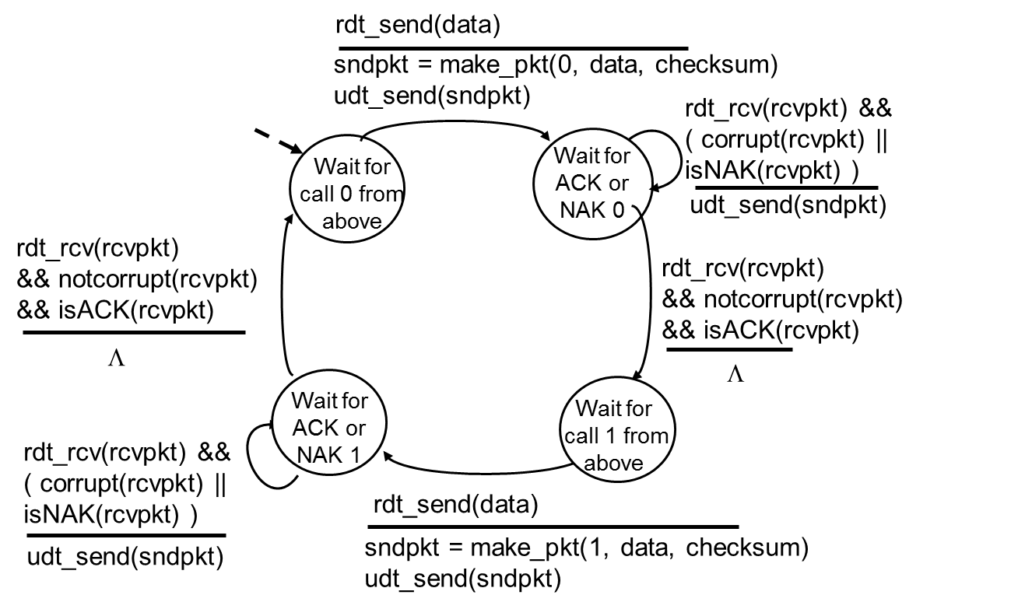
rdt2.1: sender, handles garbled ACK/NAKs

Slide 14
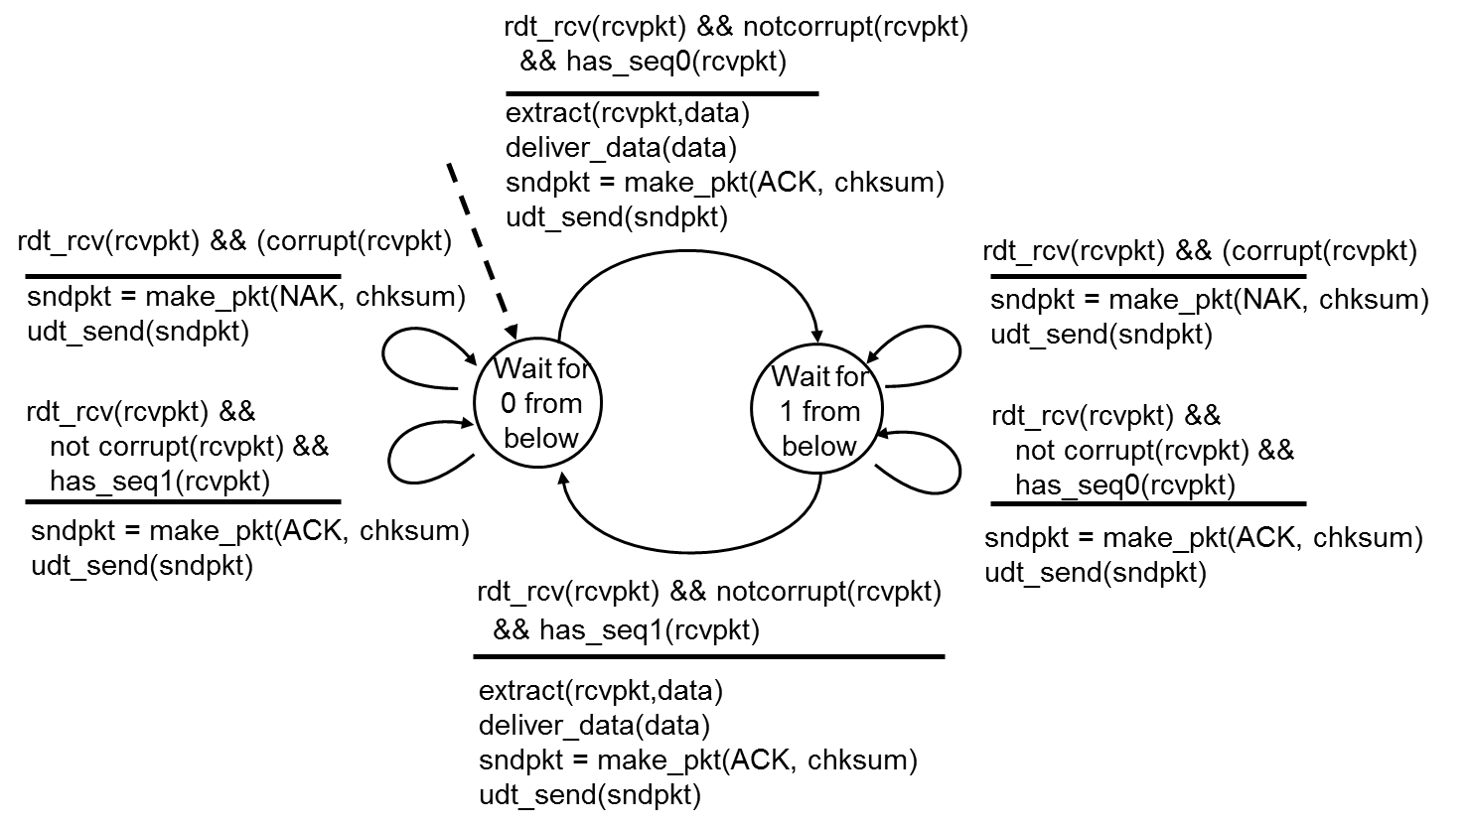
rdt2.1: receiver, handles garbled ACK/NAKs

Slide 15
rdt2.2: a NAK-free protocol
same functionality as rdt2.1, using ACKs only
instead of NAK, receiver sends ACK for last pkt received OK
receiver must explicitly include seq # of pkt being ACKed
duplicate ACK at sender results in same action as NAK: retransmit current pkt

Slide 16
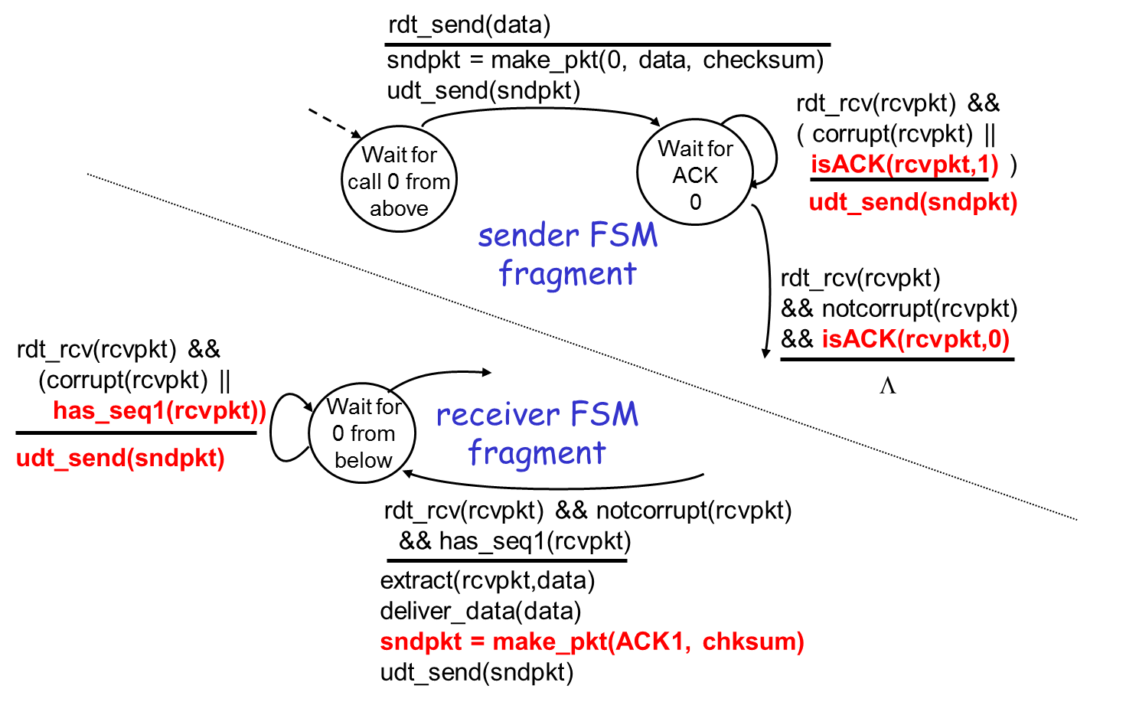
rdt2.2: sender, receiver fragments

Slide 17
rdt3.0: channels with errors and loss
New assumption: underlying channel can also lose packets (data or ACKs)
checksum, seq. #, ACKs, retransmissions will be of help, but not enough
Approach: sender waits “reasonable” amount of time for ACK
retransmits if no ACK received in this time
if pkt (or ACK) just delayed (not lost):
retransmission will be duplicate, but use of seq. #’s already handles this
receiver must specify seq # of pkt being ACKed
requires countdown timer

Slide 18
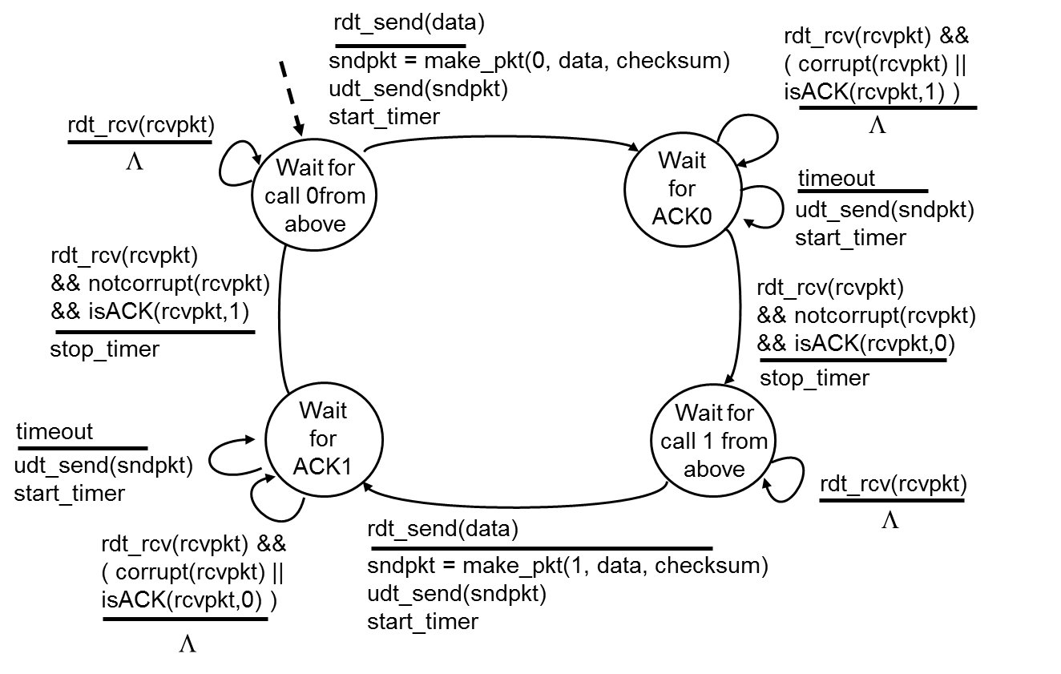
rdt3.0 sender

Slide 19
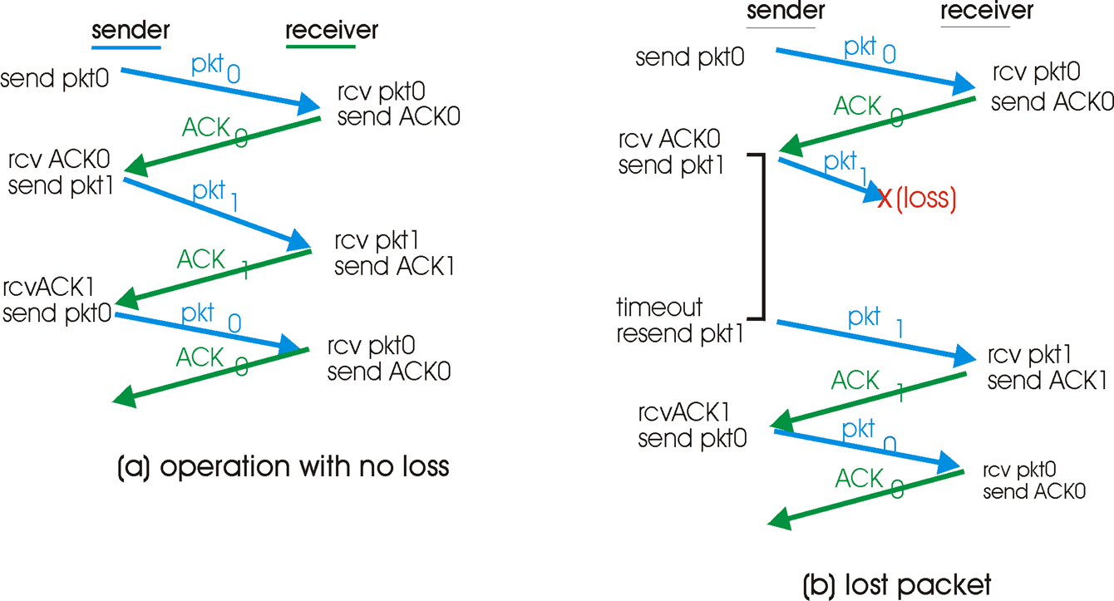
rdt3.0 in action

Slide 20
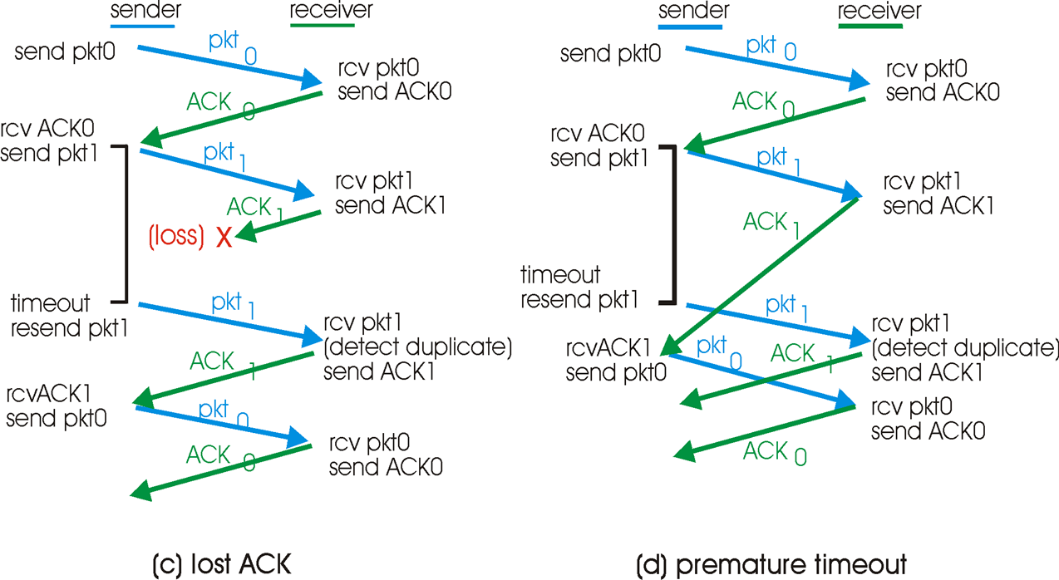
rdt3.0 in action

Slide 21

Summary
How to handle bit errors?
How to handle packet loss?

